Slide 1
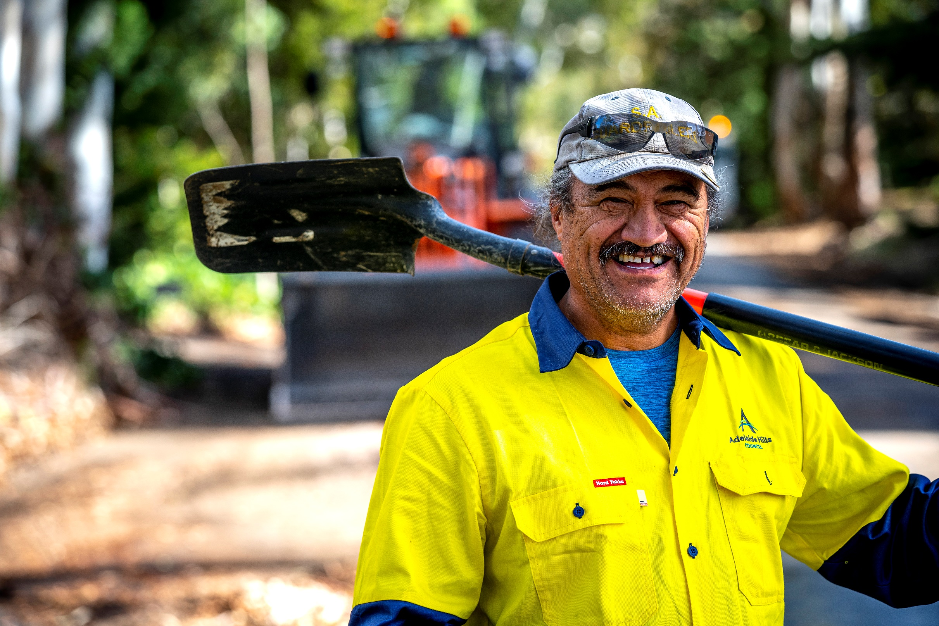
Doing business with Council:
Procurement information session

Slide 2
Your Procurement Team
James Greenfield
Procurement Coordinator
(08) 8408 0400
procurement@ahc.sa.gov.au
ahc.sa.gov.au/council/contracts-and-tenders
ahc.sa.gov.au

Slide 3
Doing business with Council
7:30am Welcome and introductions 7:45am Presentations:
How to do business with Adelaide Hills Council James Greenfield, AHC Procurement Coordinator
Local Government Association Procurement Andrew Haste, LGA Procurement Chief Executive Officer
Quotes and Tenders response documents James Greenfield, AHC Procurement Coordinator
8:30am Open Conversation Ask your questions and find out more.
8:55am Wrap up James Greenfield, AHC Procurement Coordinator
9:00am Workshop close
ahc.sa.gov.au

Slide 4
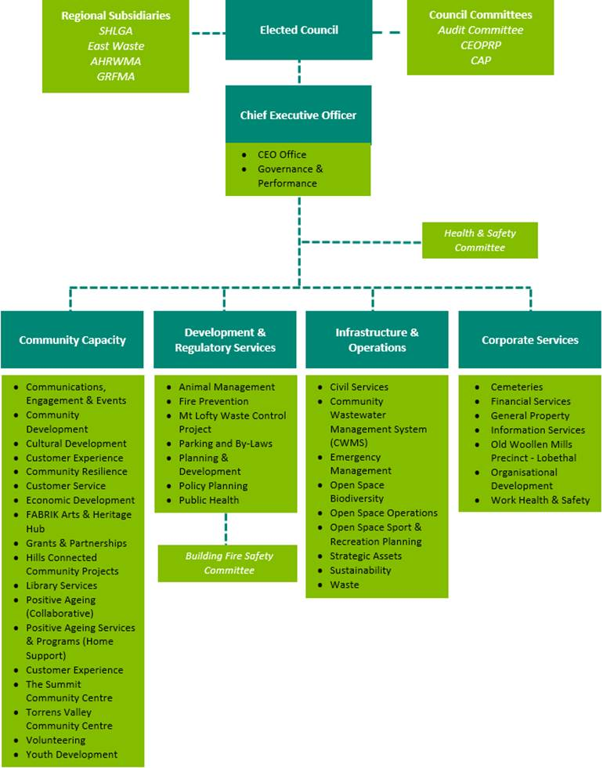
Adelaide Hills Council
ahc.sa.gov.au

Slide 5
How to do business with Council
Overview of session topics
What Council procures.
How goods and services are procured by Council.
How to access opportunities.
Lodging successful requests for quote or tender.
Compliance documentation.
Response documentation.
Your questions.
ahc.sa.gov.au

Slide 6
What Council procures
Procurement statistics
Every year Adelaide Hills Council:
Purchases over $30 million of goods and services;
Utilises around 1,000 suppliers; and
Processes over 17,000 transactions.
Council has over 60 purchasing delegates who are authorised to procure goods and services for their relevant teams.
ahc.sa.gov.au

Slide 7
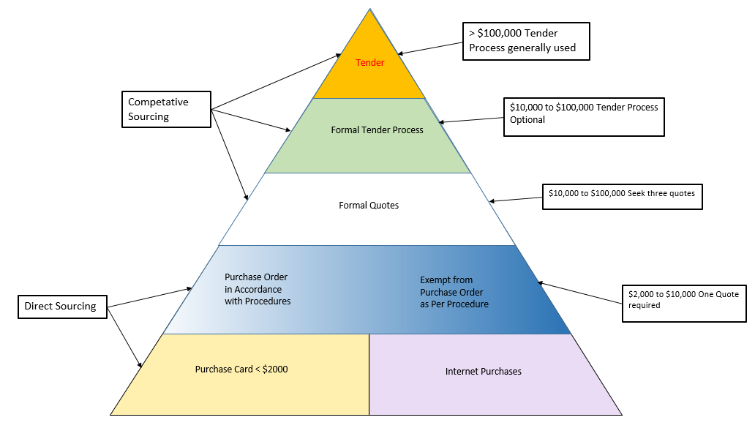
How goods and services are procured
Procurement methods
ahc.sa.gov.au

Slide 8
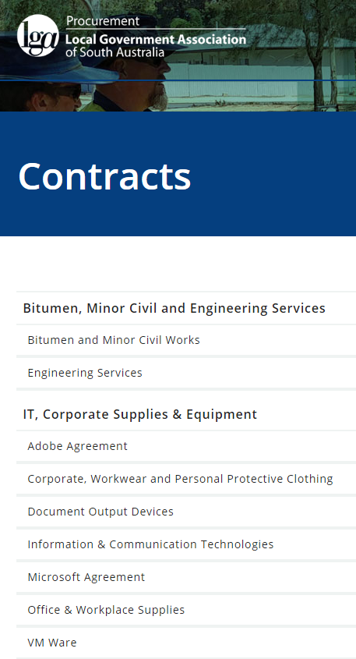
How to access opportunities
Sourcing suppliers
Direct Sourcing
lga.sa.gov.au/LGAProcurement
ahc.sa.gov.au

Slide 9
How to access opportunities
Direct Procurement, >$10,000
The appropriate method of procurement will be determined by reference to a number of factors, including value of the purchase, risks associated with the purchase, and aspects relating to the availability of supply and other market conditions.
The complexity of the purchase determines how Council will approach suppliers. A simple purchase may be a request by email, whereas something more complex may require a detailed formal submission.
Council sometimes goes direct to suppliers to request quotes. We maintain list of suppliers who are actively interested in working with Council.
If interested in being on this list forward business name, contact phone, email, postal address, and the capabilities of your business to procurement@ahc.sa.gov.au.
ahc.sa.gov.au

Slide 10
How to access opportunities
Market approach
Request for Quotation (RFQ)
The process of obtaining written quotations from prospective suppliers.
Generally suitable for purchases below $100,000 (ex GST).
Request for Tender (RFT) - Tenders SA
A formal invitation for the procurement of goods or services.
Typical for more complex procurements, or those with a value above $100,000 (ex GST).
Note: we may use a Open RFT process if we don’t know the market or we are researching the market.
ahc.sa.gov.au

Slide 11
How to access opportunities
SA Tenders and Contracts
tenders.sa.gov.au/welcome
ahc.sa.gov.au

Slide 12
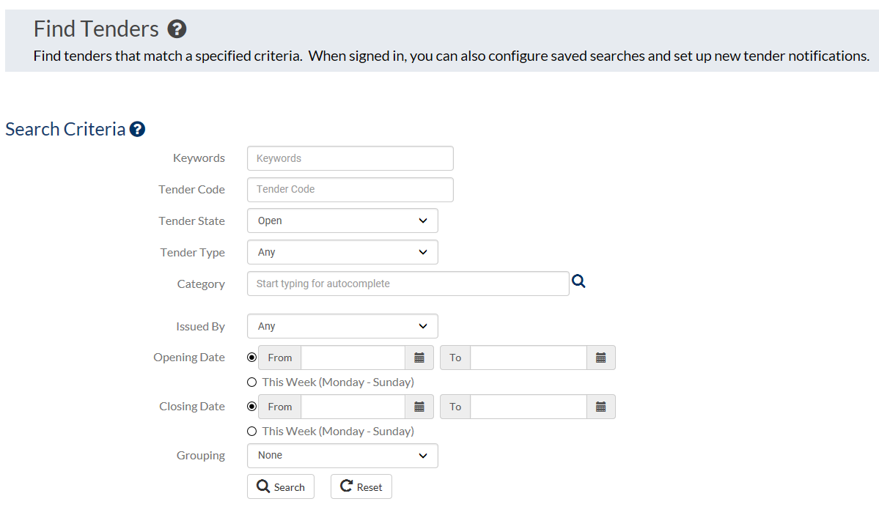
How to access opportunities
SA Tenders and Contracts
Search and receive email notifications of opportunities when they are released.
ahc.sa.gov.au

Slide 13
The benefits of partnering
LGA Procurement
Access new customers
Gain easier access to 68 councils and 30 other local government bodies across South Australia.
Save time
Reduce the need to respond multiple council tenders.
Use a simple online quotation process to respond to opportunities.
Save money
Reduce tendering and administrative costs.
Reduce risk
Take advantage of rigorous, fair and open tender processes.
Ensure compliance with Local Government Act (SA) 1999, section 49.
Access expert support and assistance.
ahc.sa.gov.au

Slide 14
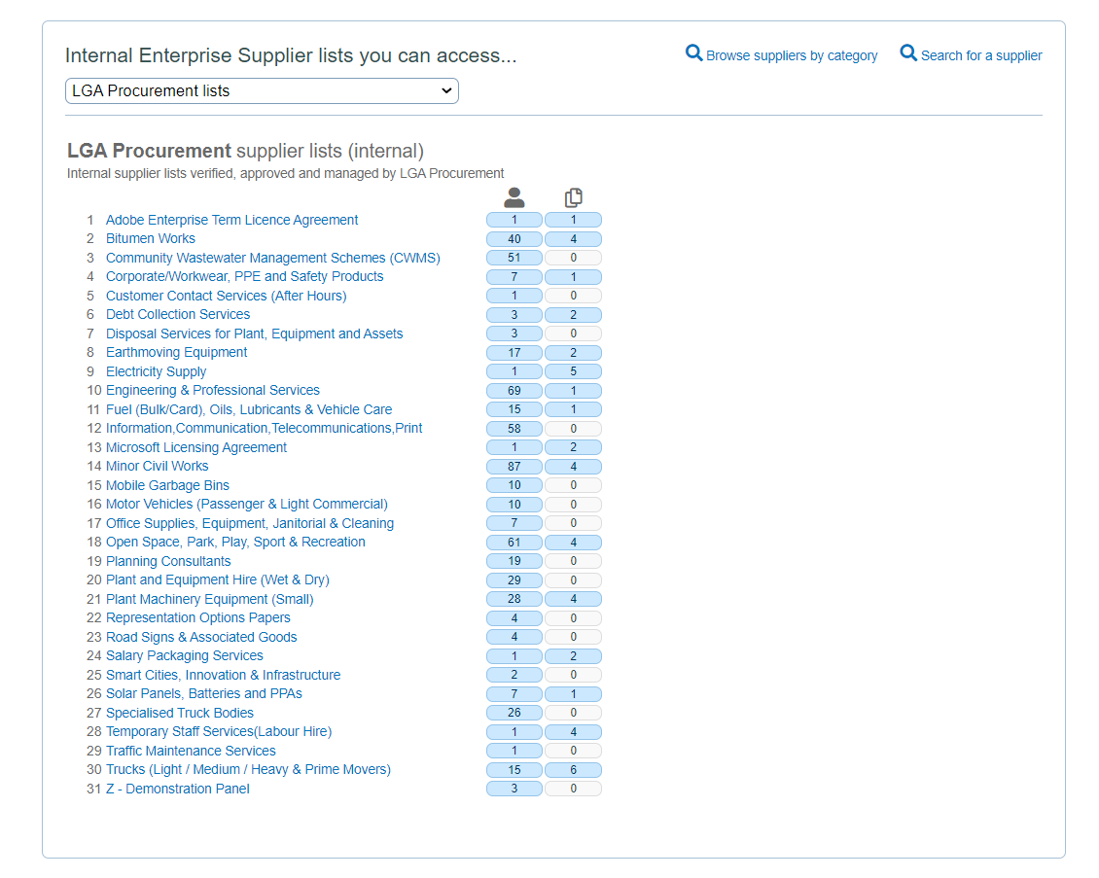
Types of Preferred Suppliers
LGA Procurement
ahc.sa.gov.au

Slide 15
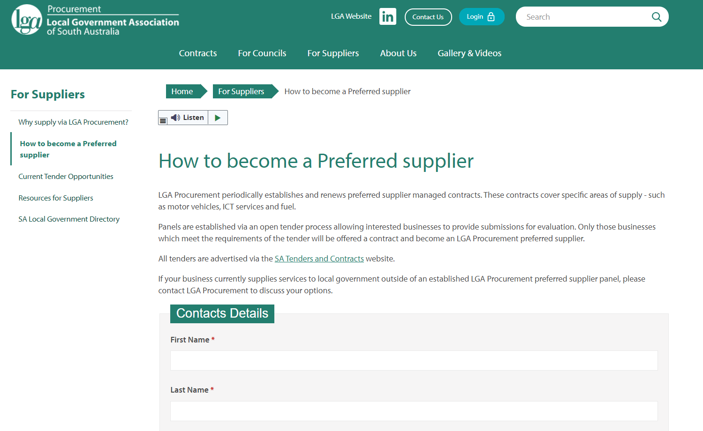
How to become a Preferred Supplier
LGA Procurement
ahc.sa.gov.au
Notes:
Refer to handout

Slide 16
Current Tender Opportunities
LGA Procurement
Guides for using the SA Tenders and Contract website can be found on the Document Library page under the Help/FAQ menu of tenders.sa.gov.au.
For more information about the LGA’s role regarding the website click here.
For more information about the print advertisement service see: Advertising Guide for Councils.
Click here to view open tenders issued by Local Government Association Procurement.
ahc.sa.gov.au
Notes:
Refer to handout

Slide 17
Preparation of a response
Overview of session topics
Guidelines for successful submissions.
What a typical RFT document contains.
Response schedules required for a tender.
Evaluation of Tender Responses.
Group questions.
ahc.sa.gov.au

Slide 18
Preparation of a Response
Guidelines for Successful Submissions
4. Sell yourself
Sell yourself as to why you are the best option. Are you sustainable in your business practices - environmentally aware; provide employment to disadvantage groups (indigenous or other); social responsibility.
Identify any value added or innovation solutions that may be of interest to Council.
Use any debrief opportunity as an opportunity to improve future competitive bids, and provide useful feedback to Council
Circular Procurement is important to Council; highlight any recycled content in your product.
Local Economic Development is important to Council: If you are a based in the Adelaide Hill Council area ensure you mention that you are.
3. Be sure that your submission is compliant
Follow the bid rules to provide everything required.
Read the questions – do you need to provide a full document/manual, or “evidence of” (e.g. a summary).
Address all criteria requirements.
Fully complete and sign the tender lodgement form.
Lodge by the closing date, time and in the manner requested.
If a response document is provided use it.
2. Target the best opportunities
Only tender for opportunities you can provide.
Make sure the project is core to your business and is cost effective to provide.
Make sure you have the full capability and resources to deliver the project.
Try not to underestimate or over-commit your time and resources.
Mandatory is mandatory. If you can’t meet the requirement, then you can’t be considered.
1. Understand the opportunity
Make sure you read and understand what is being sought.
If in doubt seek clarification from Council.
Read all documentation and any addendum or clarification issued.
Understand the opportunity
Target the best opportunities
Be sure that your submission is compliant
Sell yourself
ahc.sa.gov.au

Slide 19
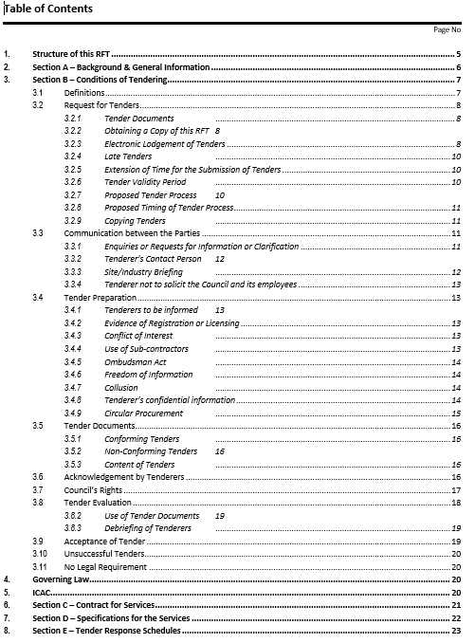
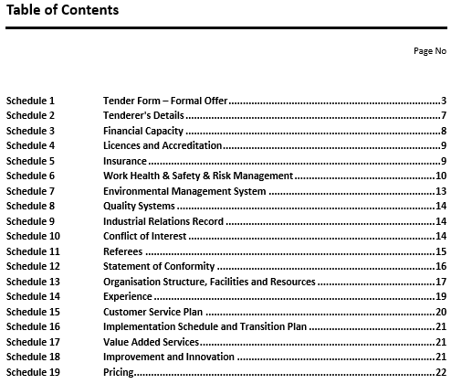
Preparation of a response
Tender Documents |
What is in the RFT document?
ahc.sa.gov.au

Slide 20
Preparation of a response
Schedule 1 – Formal Offer
Key points
Formal acceptance of the Conditions of Tender.
Agree to execute Contract if selected.
Declaration must be signed by an authorised representative.
ahc.sa.gov.au

Slide 21
Preparation of a response
Schedule 2 – Details of Tenderer
Key points
Ensure accuracy of details.
An opportunity to request amendments and provide comments.
ahc.sa.gov.au

Slide 22
Preparation of a response
Schedule 3 – Financial Capacity
Key points
Complete summary details.
Provide certified copies of accounts.
Provide comments if document/details are being withheld.
ahc.sa.gov.au

Slide 23
Preparation of a response
Schedule 4 – Licences and Accreditation
Key points
Ensure mandatory licencing is identified for the project.
Include as much detail as possible; this is an opportunity to differentiate your business.
Provide copies of certificates and any supporting evidence.
ahc.sa.gov.au

Slide 24
Preparation of a response
Schedule 5 – Insurance
Key points
Ensure all policies are listed and cover is adequate for the project (as a guide Council requests $20,000,000 public liability)
Provide copies as supporting evidence
ahc.sa.gov.au

Slide 25
Preparation of a response
Schedule 6 – Work Health and Safety and Risk Management
Key points
Answer all questions accurately
Provide copies of certificates, policies and supporting documents if requested
ahc.sa.gov.au

Slide 26
Preparation of a response
Schedule 7 – Environmental Management System
Key points
ISO accredited in Environmental Management is not mandatory.
Provide copies of certificates, policies and supporting documents.
Adelaide Hills Council • Doing business with Council – 17 November 2021
ahc.sa.gov.au

Slide 27
Preparation of a response
Schedule 8 – Quality Systems
Key points
ISO accredited in Quality Systems is not mandatory.
Provide copies of certificates, policies and supporting documents.
ahc.sa.gov.au

Slide 28
Preparation of a response
Schedule 9 – Industrial Relations Record
Key points
Answer all questions accurately
Provide additional details if answered ‘Yes’ to any questions
Relates to matters in the last 36 months
Includes related entities, listed subcontractors and shareholders
ahc.sa.gov.au

Slide 29
Preparation of a response
Schedule 10 – Conflict of Interest
Key points
Can be an actual, potential or perceived conflict
Indicate ‘No Conflict of Interest’ if no conflicts exists
ahc.sa.gov.au

Slide 30
Preparation of a response
Schedule 11 – Referees
Key points
Provide referees with relevance; similar type and size.
Do not use Adelaide Hills Council referees; previous work with Council will be taken into consideration as required.
Include all details, including contact numbers and spends.
ahc.sa.gov.au

Slide 31
Preparation of a response
Schedule 12 – Statement of Conformity
Key points
Use this schedule to lodge responses that are;
Non-conforming
Partially conforming
for an Alternate Offer
Include as much detail as possible to clearly identify the area of difference and reason
ahc.sa.gov.au

Slide 32
Preparation of a response
Schedule 13 - Organisation Structure, Facilities and Resources
Key points
Provide details of key personnel, equipment, facilities and resources that will be specifically used in the delivery of the project.
Include as much details as possible; use this area to sell your business and demonstrate you can deliver the project.
Include supporting evidence; org charts, CVs, listed subcontractor specialised details.
ahc.sa.gov.au

Slide 33
Preparation of a response
Schedule 14 – Experience
Key points
Provide details of experience in delivering similar projects in the last five years.
Include sufficient detail; be transparent.
Answer all questions.
ahc.sa.gov.au

Slide 34
Preparation of a response
Schedule 15 - Customer Service Plan
Key points
Provide details of the systems and processes in place to respond to enquiries, complaints and requests for assistance from members of the public.
This will be project specific.
Include supporting evidence; copies of procedures, qualifications of staff, examples.
ahc.sa.gov.au

Slide 35
Preparation of a response
Schedule 16 – Implementation Schedule and Transition Plan
Key points
Provide a comprehensive project plan; list all activities required and proposed timeline for each activity (Gantt charts are good for showing this).
Include a methodology; how activities will be undertaken and delivered.
ahc.sa.gov.au

Slide 36
Preparation of a response
Schedule 17 – Value Add Service
Key points
What additional benefits will be gained by Council should you be the successful tenderer?
Use this schedule to differentiate you from the competition.
ahc.sa.gov.au

Slide 37
Preparation of a response
Schedule 18 – Improvement and Innovation
Key points
What improvements/innovations your company can provide to improve the delivery.
Use this schedule to differentiate you from the competition.
ahc.sa.gov.au

Slide 38
Preparation of a response
Schedule 19 – Sustainable Procurement
Key points
Do you provide an employment opportunities for disadvantaged groups?
Do you provide support the use of local suppliers in the AHC area?
Do you include any recycled content in your product?
ahc.sa.gov.au

Slide 39
Preparation of a response
Schedule 20 – Pricing
Key points
Provide a breakdown of the costs for the services and/or each type of service (if applicable) and/or breakdown of fixed and variable costs (if applicable).
ahc.sa.gov.au

Slide 40
Preparation of a response
Submission Tips
Follow tender/quote instructions.
Use the supplied templates.
Address all the schedules and criteria.
Provide accurate details and proof read.
Sign all areas requiring a signature.
Choose the right references.
Submit a competitive price.
Lodge your tender on time.
ahc.sa.gov.au

Slide 41
Group Questions
ahc.sa.gov.au

Slide 42
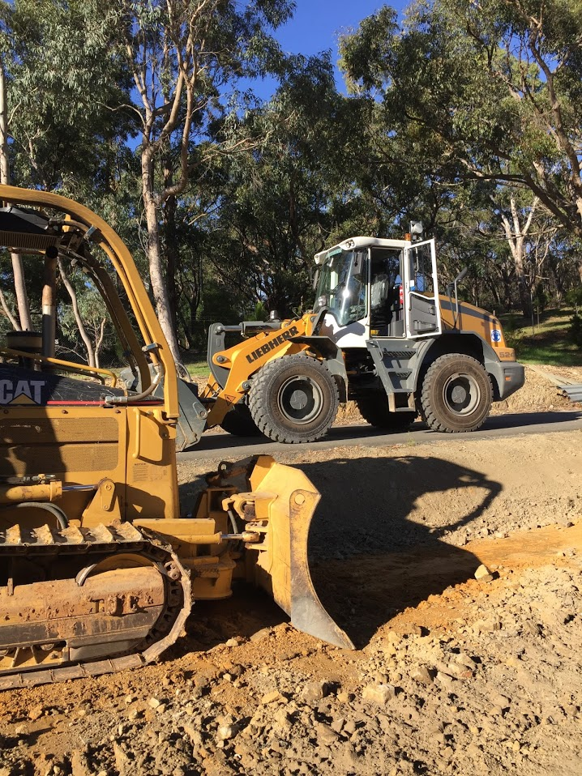
Information Session Close
Thank you for your participation

